Slide 1
Little Languages

Slide 2
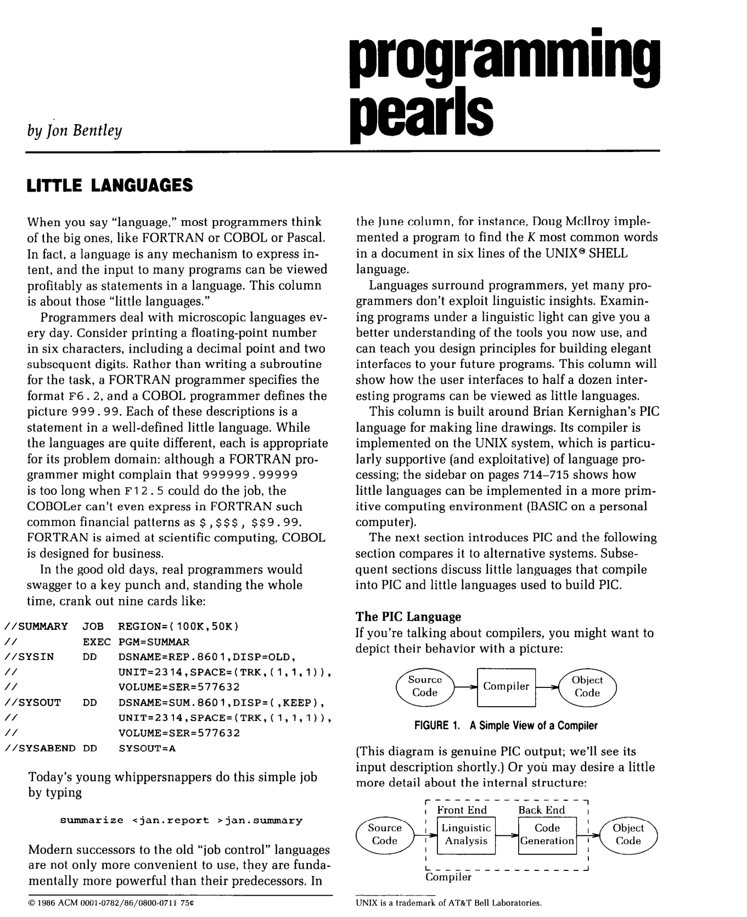
Little Languages (from Unix)
Bentley (CACM-1986)

Slide 3
We propose gft, a Little Language
In the good old days,
real programmers would copy a few hundred lines of
PyTorch from HuggingFace
and modify as necessary to change
models,
datasets,
task,
etc.
With gft, 100s of lines → 1-line
More accessible to masses
(including non-programmers)

Slide 4
Standard 3-Step Recipe
Step | Description | Time | Hardware
1
2
3 | Inference (predict) | Seconds/Minutes | 0+ GPUs
Easy

Slide 5
Standard 3-Step Recipe
Most users should not do this themselves
Step | Description | Time | Hardware
1 | Pre-Training | Days/Weeks | Large GPU cluster
2
3 | Inference (predict) | Seconds/Minutes | 0+ GPUs

Slide 6
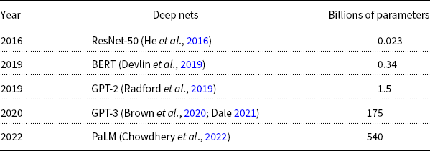
Hard: Pre-Training Large Language Models (LLMs)
GPT-3
PaLM
GPT-2
BERT
ResNet
Most users should not invest in pretraining
because growth (& costs) are out of control

Slide 7
Standard 3-Step Recipe
Step | Description | Time | Hardware
1 | Pre-Training | Days/Weeks | Large GPU cluster
2 | Fine-Tuning (fit) | Hours/Days | 1+ GPUs
3 | Inference (predict) | Seconds/Minutes | 0+ GPUs
Not Hard

Slide 8
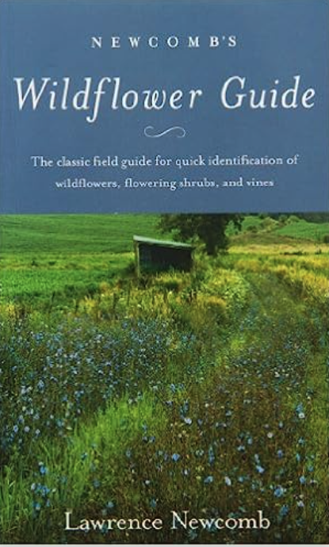
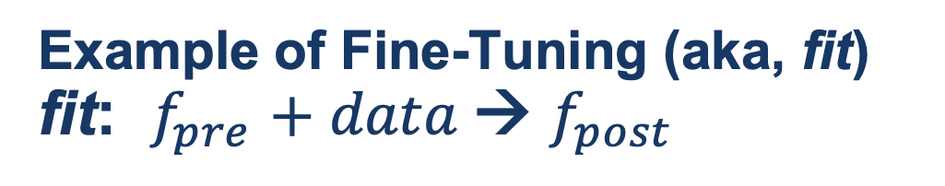
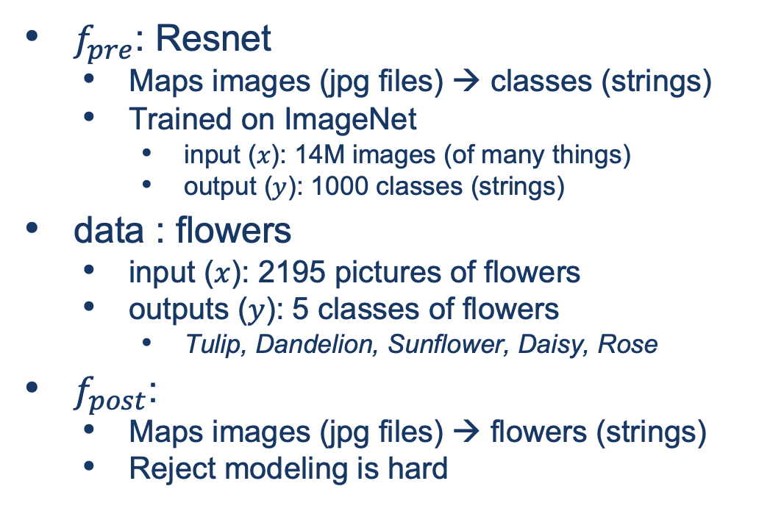
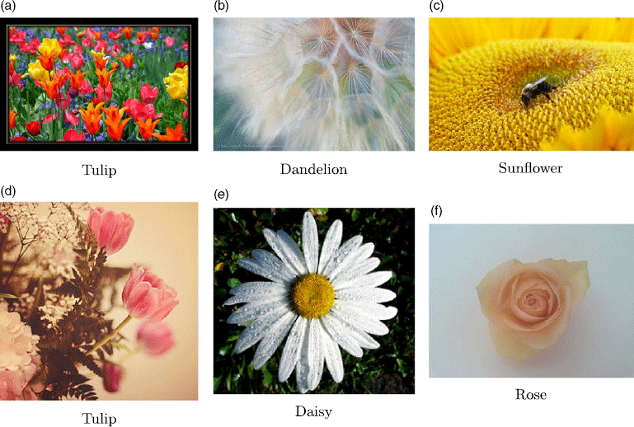
Guide Book App

Slide 9
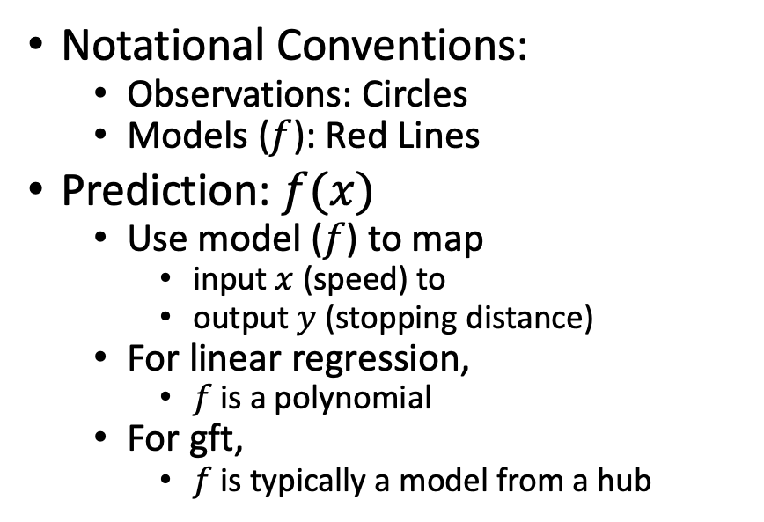
Fine-Tuning (Fit) in R (Statistics Package)
Make deep nets look like regression
(Not much programming)
Black Points:
cars dataset
Notational Conventions:
Observations: Circles
Models ($f$): Red Lines
Prediction: $f(x)$
Use model ($f$) to map
input $x$ (speed) to
output $y$ (stopping distance)
For linear regression,
$f$is a polynomial
For gft,
$f$is typically a model from a hub
Red Line:
Model (f)

Slide 10
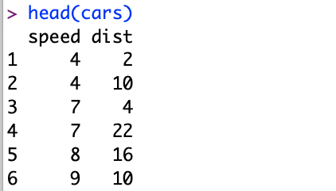
Datasets Example: Cars
Two Columns:
cars$speed
cars$dist

Slide 11
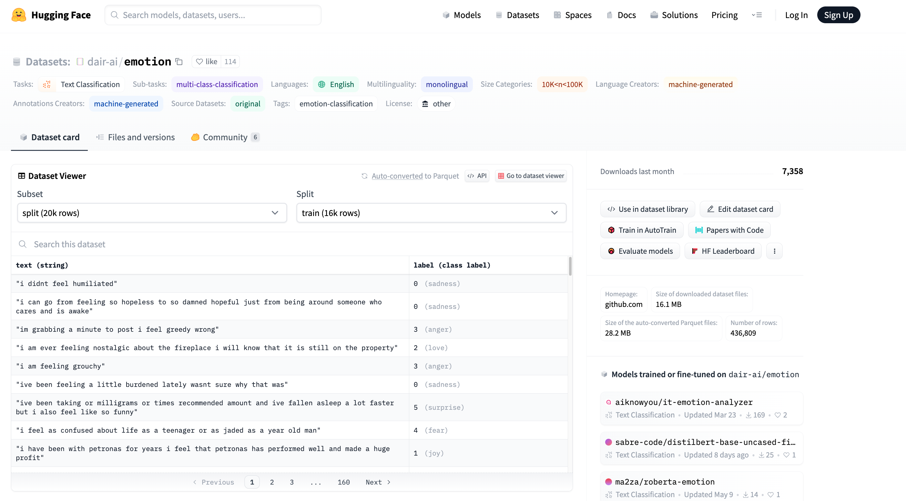


Example of Datasets in HuggingFace https://huggingface.co/datasets/dair-ai/emotion
$$x$$
$$y$$

Slide 12
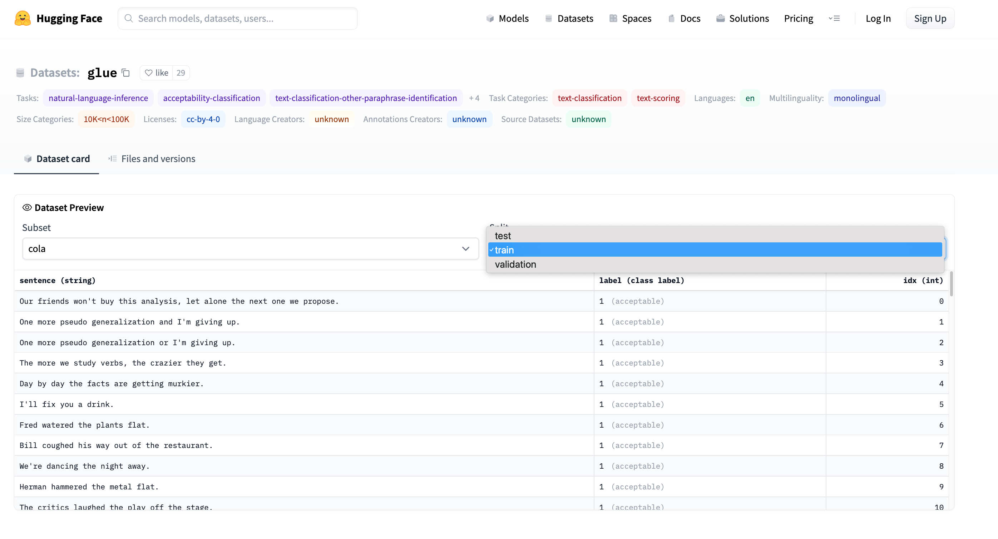
Emotion → GLUE (Cola) https://huggingface.co/datasets/glue/viewer/cola/train
Terminology: Splits
Terminology: Subset

Slide 13
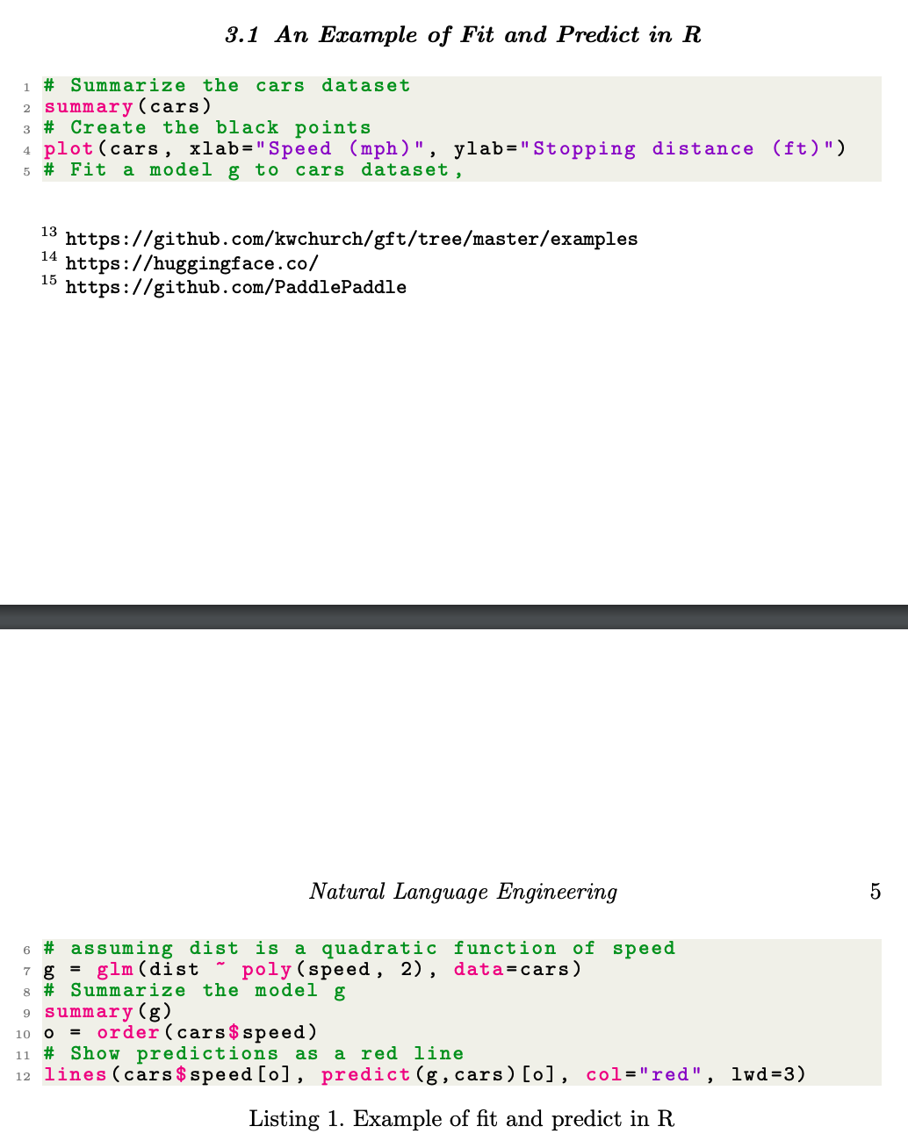
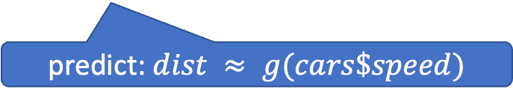
glm (General Linear Models) in R (and Sklearn)
glm: fit poly model with data
predict: $dist ≈ g(cars\$speed)$

Slide 14
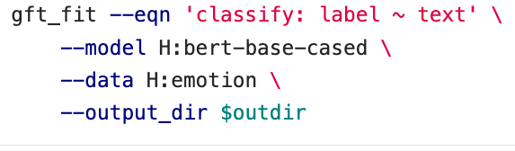
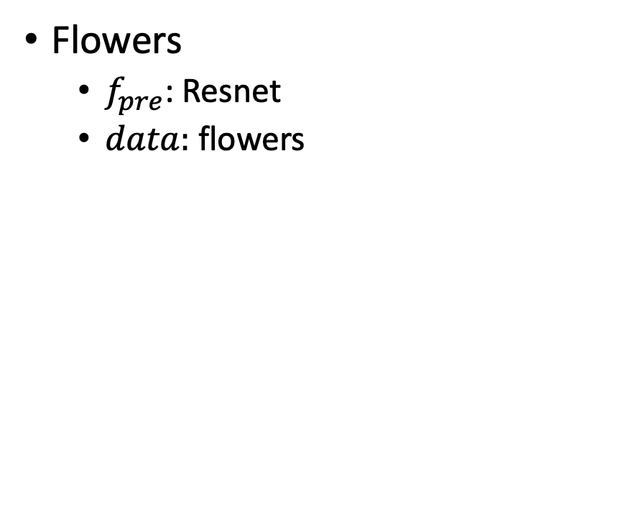
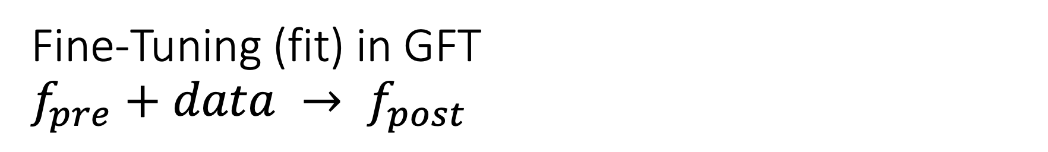
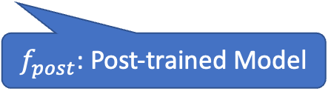
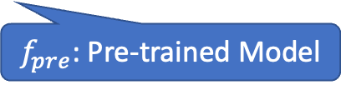
Fine-Tuning (fit) in GFT $f_{pre}+data → f_{post}$
Flowers
$f_{pre}$: Resnet
$data:$flowers
$f_{pre}$: Pre-trained Model
$f_{post}$: Post-trained Model
Fine-Tuning (fit) in R

Slide 15
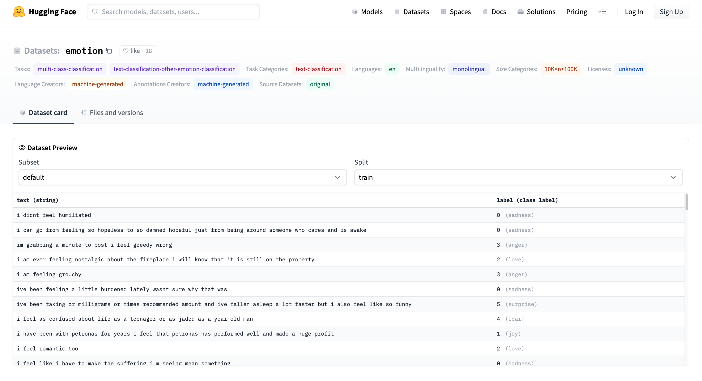
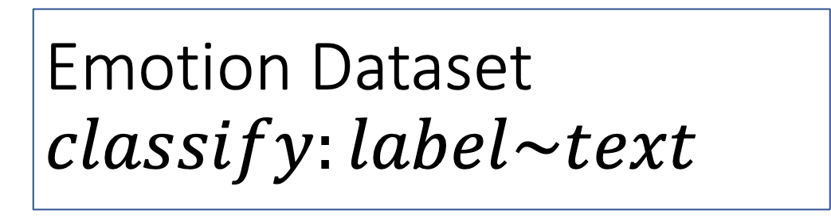
Emotion Dataset $$classify:label\sim text$$
Task/Loss
Columns
Columns
Row

Slide 16
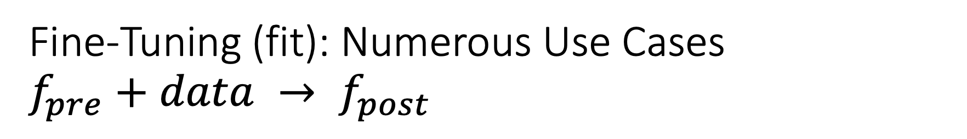
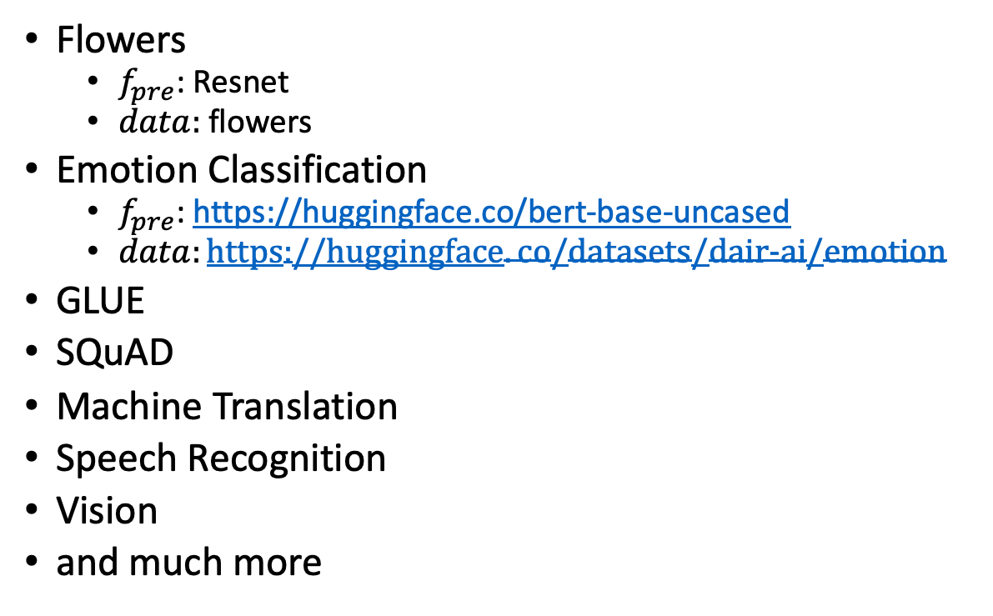
Fine-Tuning (fit): Numerous Use Cases $f_{pre}+data → f_{post}$
Flowers
$f_{pre}$: Resnet
$data:$flowers
Emotion Classification
$f_{pre}$: https://huggingface.co/bert-base-uncased
$data:https://huggingface.co/datasets/dair-ai/emotion$
GLUE
SQuAD
Machine Translation
Speech Recognition
Vision
and much more
$f_{pre}$: Pre-trained Model
$f_{post}$: Post-trained Model
Fine-Tuning (fit) in R

Slide 17
GLUE Subsets
GLUE COLA SUBSET
Sentence | Label
Bill sang himself to sleep. | 1 (acceptable)
Bill squeezed the puppet through the hole. | 1 (acceptable)
Bill sang Sue to sleep. | 1 (acceptable)
The elevator rumbled itself to the ground. | 0 (unacceptable)
If the telephone rang, it could ring itself silly. | 1 (acceptable)
She yelled hoarse. | 0 (unacceptable)
Ted cried to sleep. | 0 (unacceptable)
The tiger bled to death. | 1 (acceptable)
Subset | Dataset
COLA | H:glue,cola
SST2 | H:glue,sst2
WNLI | H:glue,wnli
MRPC | H:glue,mrpc
QNLI | H:glue,qnli
QQP | H:glue,qqp
SSTB | H:glue,sstb
MNLI | H:glue,mnli

Slide 18
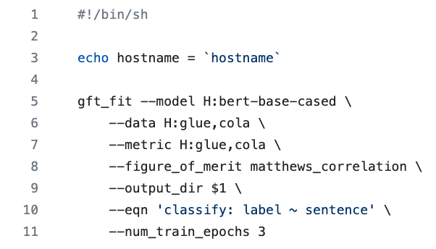
GFT Program for COLA
GLUE COLA SUBSET
Sentence | Label
Bill sang himself to sleep. | 1 (acceptable)
Bill squeezed the puppet through the hole. | 1 (acceptable)
Bill sang Sue to sleep. | 1 (acceptable)
The elevator rumbled itself to the ground. | 0 (unacceptable)
If the telephone rang, it could ring itself silly. | 1 (acceptable)
She yelled hoarse. | 0 (unacceptable)
Ted cried to sleep. | 0 (unacceptable)
The tiger bled to death. | 1 (acceptable)
https://github.com/kwchurch/gft/blob/master/examples/fit_examples/model.HuggingFace/language/data.HuggingFace/glue/cola.sh

Slide 19
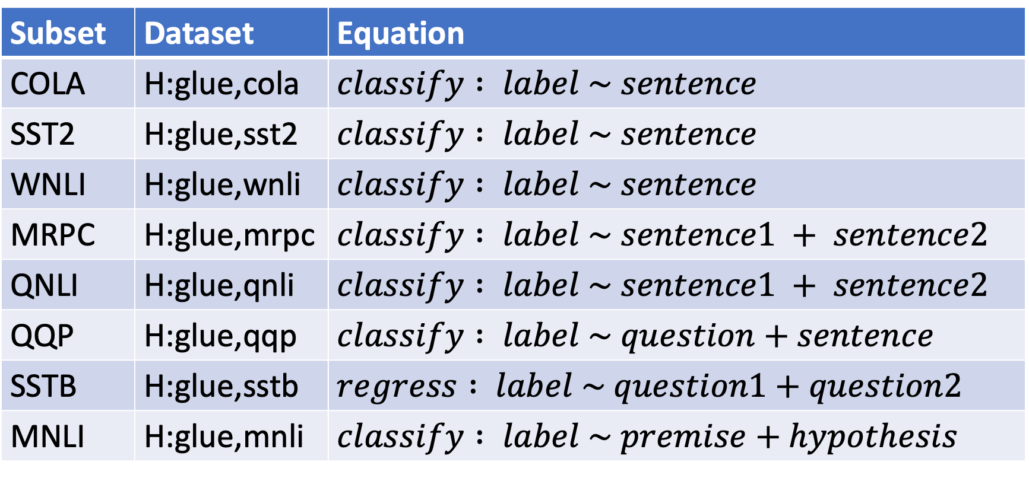
Simple Equations Cover Many Cases of Interest GLUE: A Popular Benchmark
Subset | Dataset | Equation
COLA | H:glue,cola | $$classify : label \sim sentence$$
SST2 | H:glue,sst2 | $$classify : label \sim sentence$$
WNLI | H:glue,wnli | $$classify : label \sim sentence$$
MRPC | H:glue,mrpc | $$classify : label \sim sentence1 + sentence2$$
QNLI | H:glue,qnli | $$classify : label \sim sentence1 + sentence2$$
QQP | H:glue,qqp | $$classify : label \sim question+sentence$$
SSTB | H:glue,sstb | $$regress : label \sim question1+question2$$
MNLI | H:glue,mnli | $$classify : label \sim premise+hypothesis$$

Slide 20
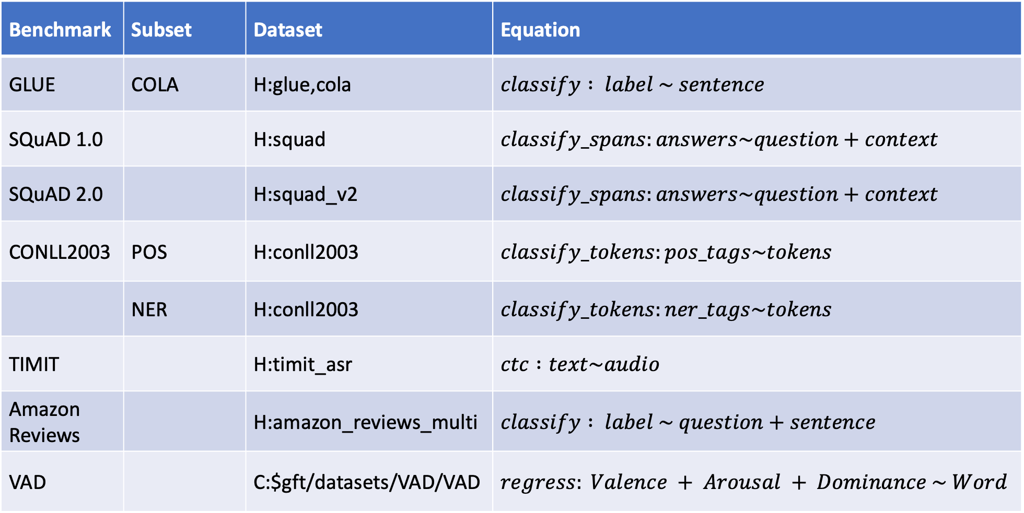
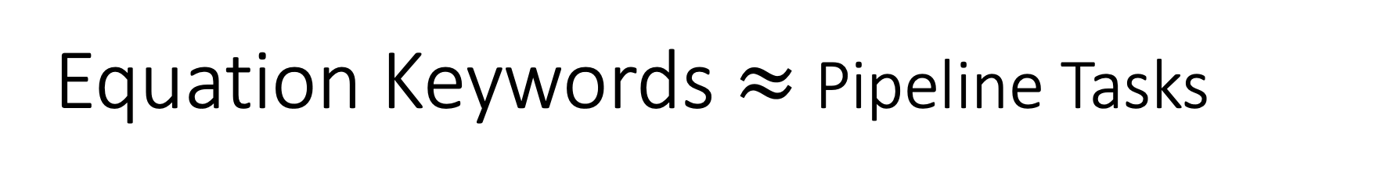
Equation Keywords $≈$ Pipeline Tasks
Benchmark | Subset | Dataset | Equation
GLUE | COLA | H:glue,cola | $$classify : label \sim sentence$$
SQuAD 1.0 |  | H:squad | $$classify_spans:answers\sim question+context$$
SQuAD 2.0 |  | H:squad_v2 | $$classify_spans:answers\sim question+context$$
CONLL2003 | POS | H:conll2003 | $$classify_tokens:pos_tags\sim tokens$$
 | NER | H:conll2003 | $$classify_tokens:ner_tags\sim tokens$$
TIMIT |  | H:timit_asr | $$ctc :text\sim audio$$
Amazon Reviews |  | H:amazon_reviews_multi | $$classify : label \sim question+sentence$$
VAD |  | C:$gft/datasets/VAD/VAD | $$regress: Valence + Arousal + Dominance \sim Word$$

Slide 21
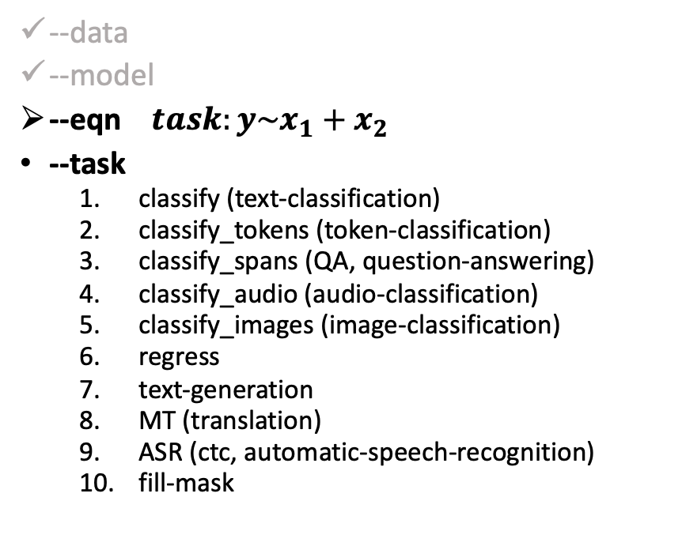
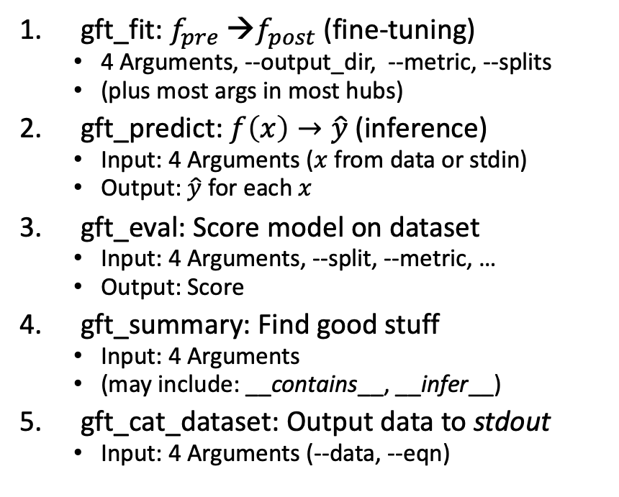
gft Cheat Sheet (General Fine-Tuning)
4+1 Functions
4 Arguments
gft_fit: $f_{pre}$ →$f_{post}$(fine-tuning)
4 Arguments, --output_dir, --metric, --splits
(plus most args in most hubs)
gft_predict: $f\left(x\right)→\hat{y}$ (inference)
Input: 4 Arguments ($x$ from data or stdin)
Output: $\hat{y}$ for each $x$
gft_eval: Score model on dataset
Input: 4 Arguments, --split, --metric, …
Output: Score
gft_summary: Find good stuff
Input: 4 Arguments
(may include: __contains__, __infer__)
gft_cat_dataset: Output data to stdout
Input: 4 Arguments (--data, --eqn)
--data
--model
--eqn $task:y\sim x_{1}+x_{2}$
--task
classify (text-classification)
classify_tokens (token-classification)
classify_spans (QA, question-answering)
classify_audio (audio-classification)
classify_images (image-classification)
regress
text-generation
MT (translation)
ASR (ctc, automatic-speech-recognition)
fill-mask

Slide 22
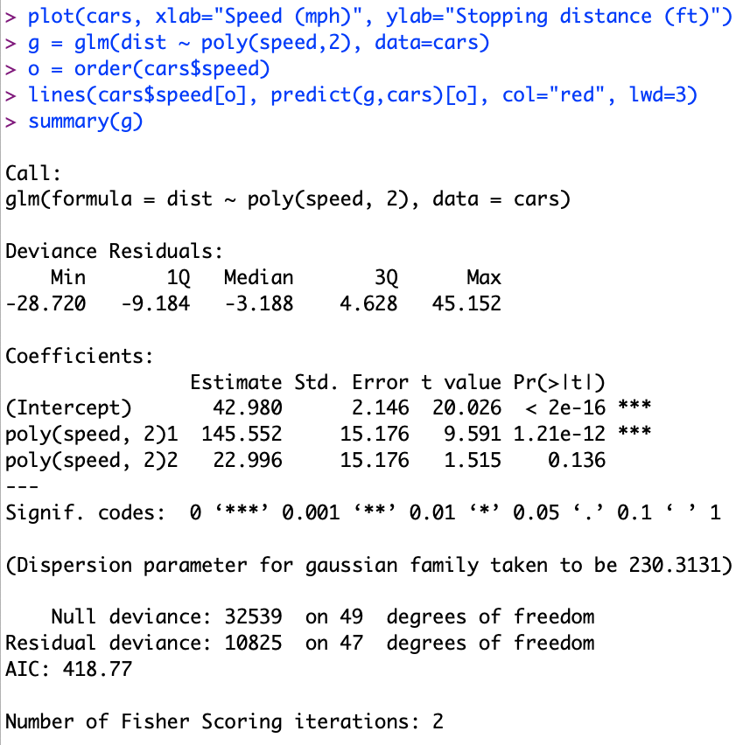
Regression in R: Summarize (almost) anything
Fit a model (g) to data (cars)

Slide 23
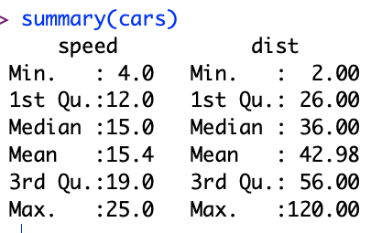
Regression in R: Summarize (almost) anything

Slide 24
Regression in R: Summarize (almost) anything
Fit a model (g) to data (cars)
Predict
Summarize a model (g)
Opportunity to Improve g

Slide 25
gft_summary
Summarize almost anything
Models
Datasets

Slide 26

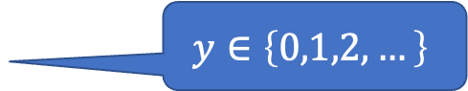

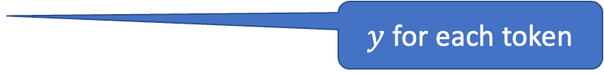

Tasks
$$y∈\left\{0,1,2,…\right\}$$
classify, text-classification
regress
QA, Question Answering, classify spans
token classification
NER (Named Entity Recognition)
POS (Part of Speech Tagging)
translation, MT
ASR, Automatic Speech Recognition, ctc
$y∈ℝ$ or $y∈ℝ^{N}$
$y$ for each start/end of span
$y$ for each token
$y$ for each phoneme

Slide 27
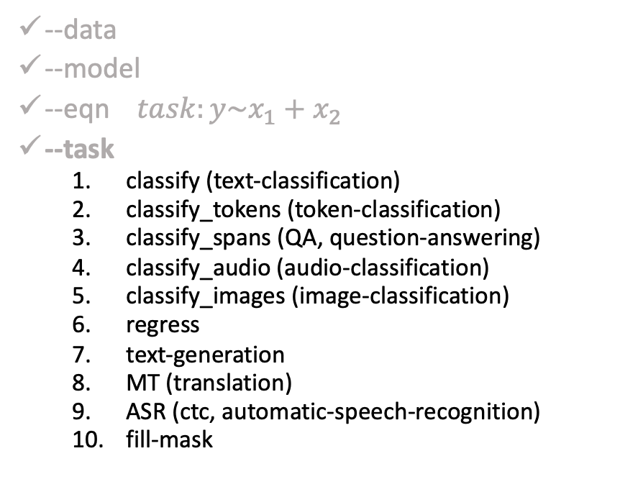
gft Cheat Sheet (General Fine-Tuning)
4+1 Functions
4 Arguments
gft_fit: $f_{pre}$ →$f_{post}$(fine-tuning)
4 Arguments, --output_dir, --metric, --splits
(plus most args in most hubs)
gft_predict: $f\left(x\right)→\hat{y}$ (inference)
Input: 4 Arguments ($x$ from data or stdin)
Output: $\hat{y}$ for each $x$
gft_eval: Score model on dataset
Input: 4 Arguments, --split, --metric, …
Output: Score
gft_summary: Find good stuff
Input: 4 Arguments
(may include: __contains__, __infer__)
gft_cat_dataset: Output data to stdout
Input: 4 Arguments (--data, --eqn)
--data
--model
--eqn $task:y\sim x_{1}+x_{2}$
--task
classify (text-classification)
classify_tokens (token-classification)
classify_spans (QA, question-answering)
classify_audio (audio-classification)
classify_images (image-classification)
regress
text-generation
MT (translation)
ASR (ctc, automatic-speech-recognition)
fill-mask

Slide 28
gft Design Goals
Inclusiveness:
Accessible to Masses
(including non-programmers)
Portability
Ease-of-Use/Transparency >> SOTA
Hide Complexity/Magic (Alchemy)
No one would suggest
Regression-like methods are ``intelligent’’

Slide 29
Portability: Inclusiveness + Hedge
gft Programs
H → HuggingFace
gft_fit --model H:bert-base-cased \
--data H:emotion \
--output_dir $1 \
--eqn 'classify: label ~ text'
Hedge
(Supply Chains)
Hedge
(Supply Chains)
P → PaddleNLP
gft_fit --model P:ernie-tiny \
--data P:chnsenticorp \
--output_dir $1 \
--eqn 'classify: label ~ text'
Emphasis on Chinese

Slide 30
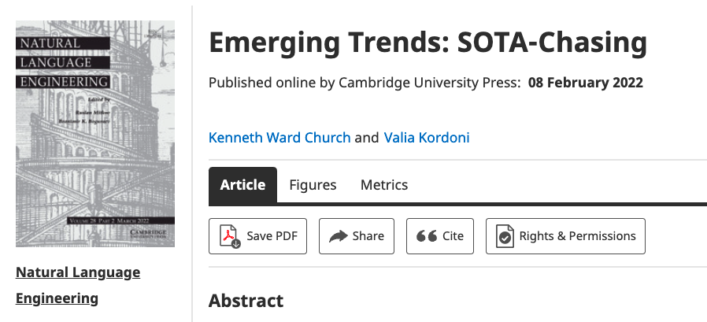
Strategy: Inclusiveness
Get your priorities right: Inclusiveness >> Exclusiveness
SOTA-Chasing 👎 (Exclusive: mine is bigger than yours)
Crossing the Chasm 👍 (Inclusive: Appeal to mainstream users)
Hubs: Get big quick 👍 (Inclusive: Usage >> SOTA)

Slide 31
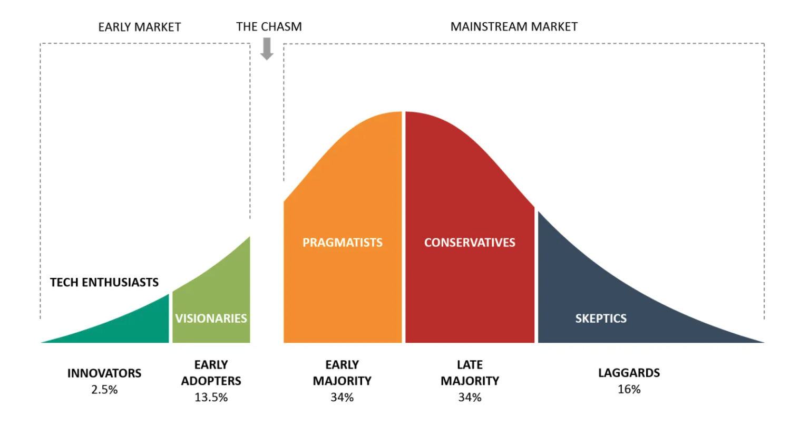
Bigger Opportunities:
(l)users (aka poets)
Engineers

Slide 32
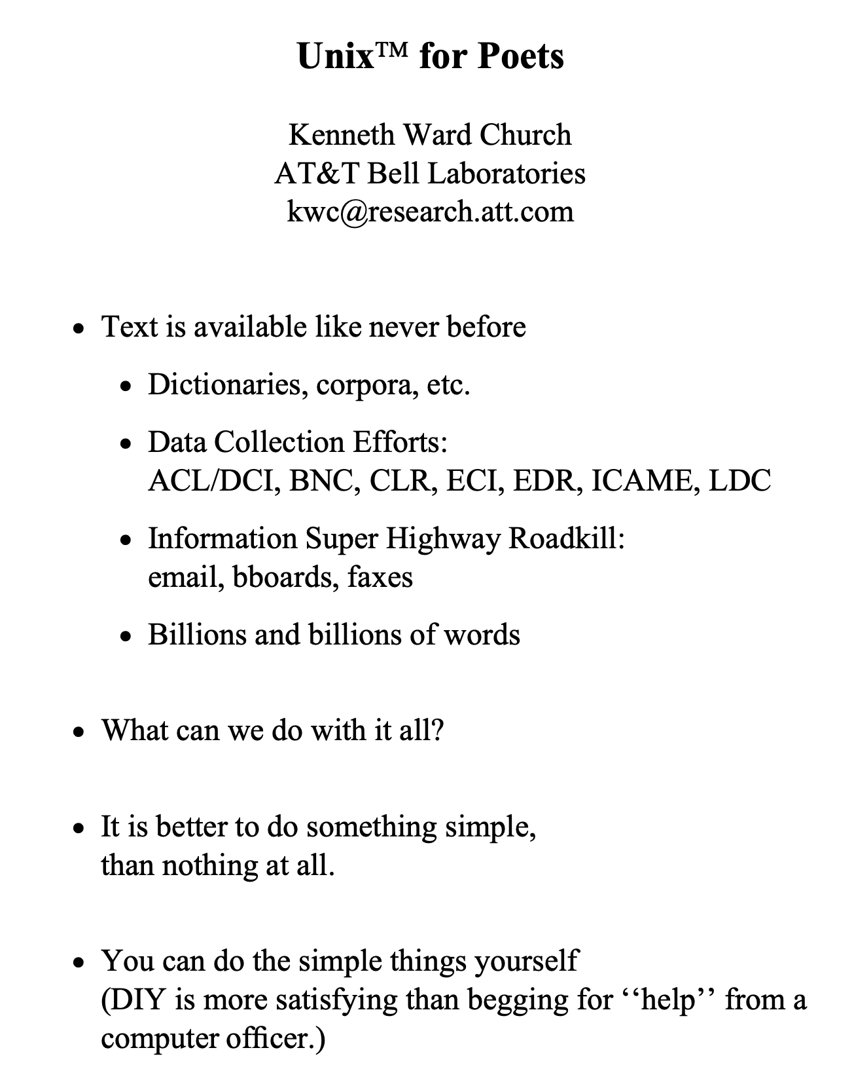
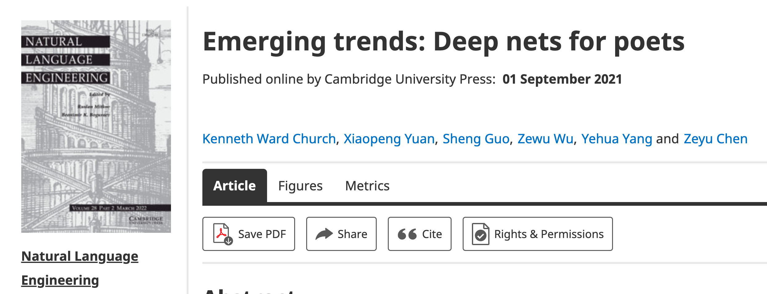
Poets
Poets is an imperfect metaphor,
intended as a gesture toward inclusion.
The future for deep nets
will benefit by reaching out to
a broad audience of potential users,
including people with
little or no programming skills,
and little interest in training models.
Lessons from success of Unix
Less is more
Inclusion: Appeal to power users as well as masses
Portability: Inclusiveness++

Slide 33
Hub Strategy: Usage >> SOTA
(Sensible) Priority for Startups
(Mistaken) Priority Research
Startup Strategy:
Get big quick
SOTA is like sprinting (hard work)
Avoid temptation to sprint to front
(except when it is worth the effort)
Hubs spend most of the race
in the peloton drafting researchers
Make it easy for 3rd parties
to post their best models on your hub
Use of 3rd parties → Wide range in quality
Best are amazing: best in class, industrial strength…
But some don’t work well, and may not even load…
Help users find good stuff & embrace community

Slide 34

Two Perspectives on Datasets
Machine Learning
Psychology (Presupposes $∃$Hypothesis)
Splits: train/val/test
Treat rows as iid
Identical and independently distributed
Idealistic, but maybe unrealistic
Changes over time, Context, etc.
More papers on models
than Datasets
Relatively little interest in
Is the Dataset Realistic?
Motivation? (Does anyone care? If so, who?)
What is the dataset testing?
Sampling/balance? From which population?
Can it be gamed? Leakage?
Validity
Content validity
Construct validity
Criterion validity
Face validity
Discriminant validity
Reliability
Inter-rater reliability
Test-retest reliability
Internal reliability/Inter-item consistency
Split half reliability
Lexicography

Slide 35
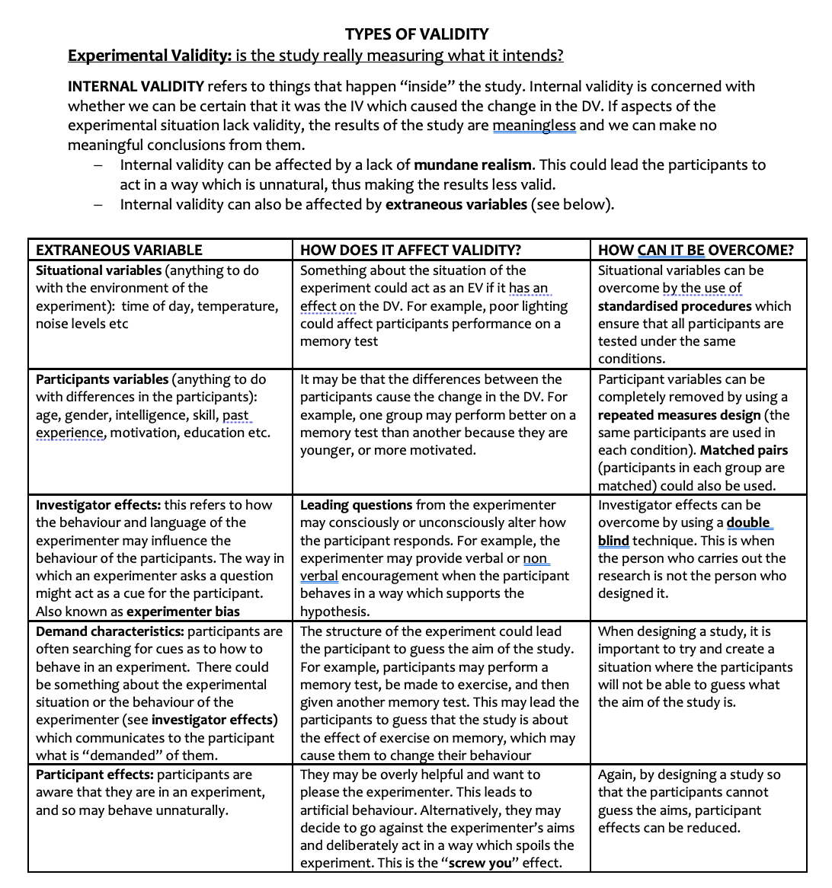
Discussion of Validity Assumes: Intention

Slide 36
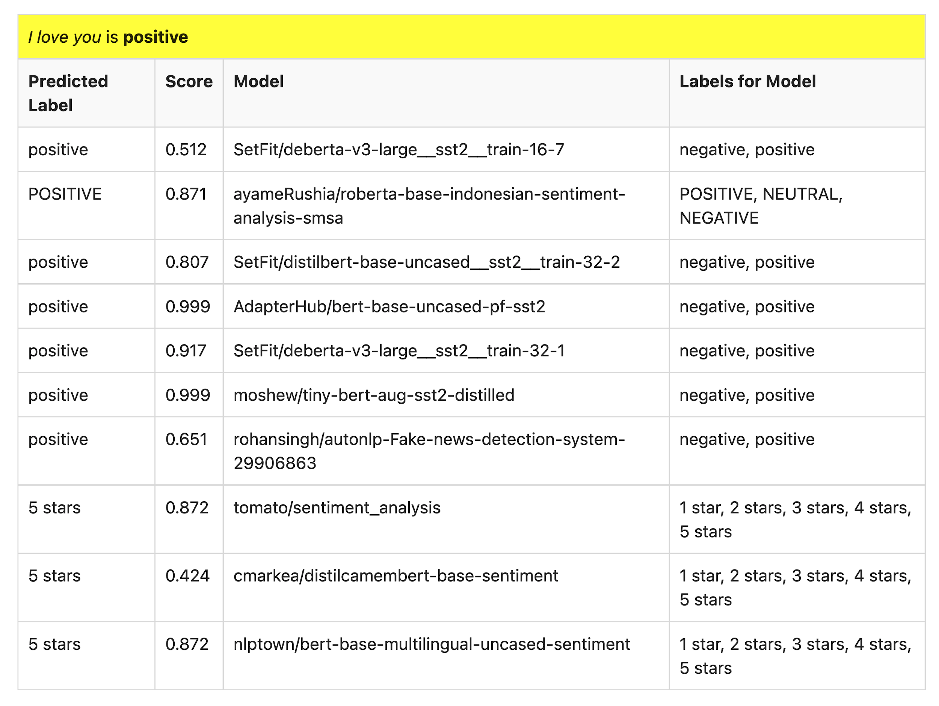
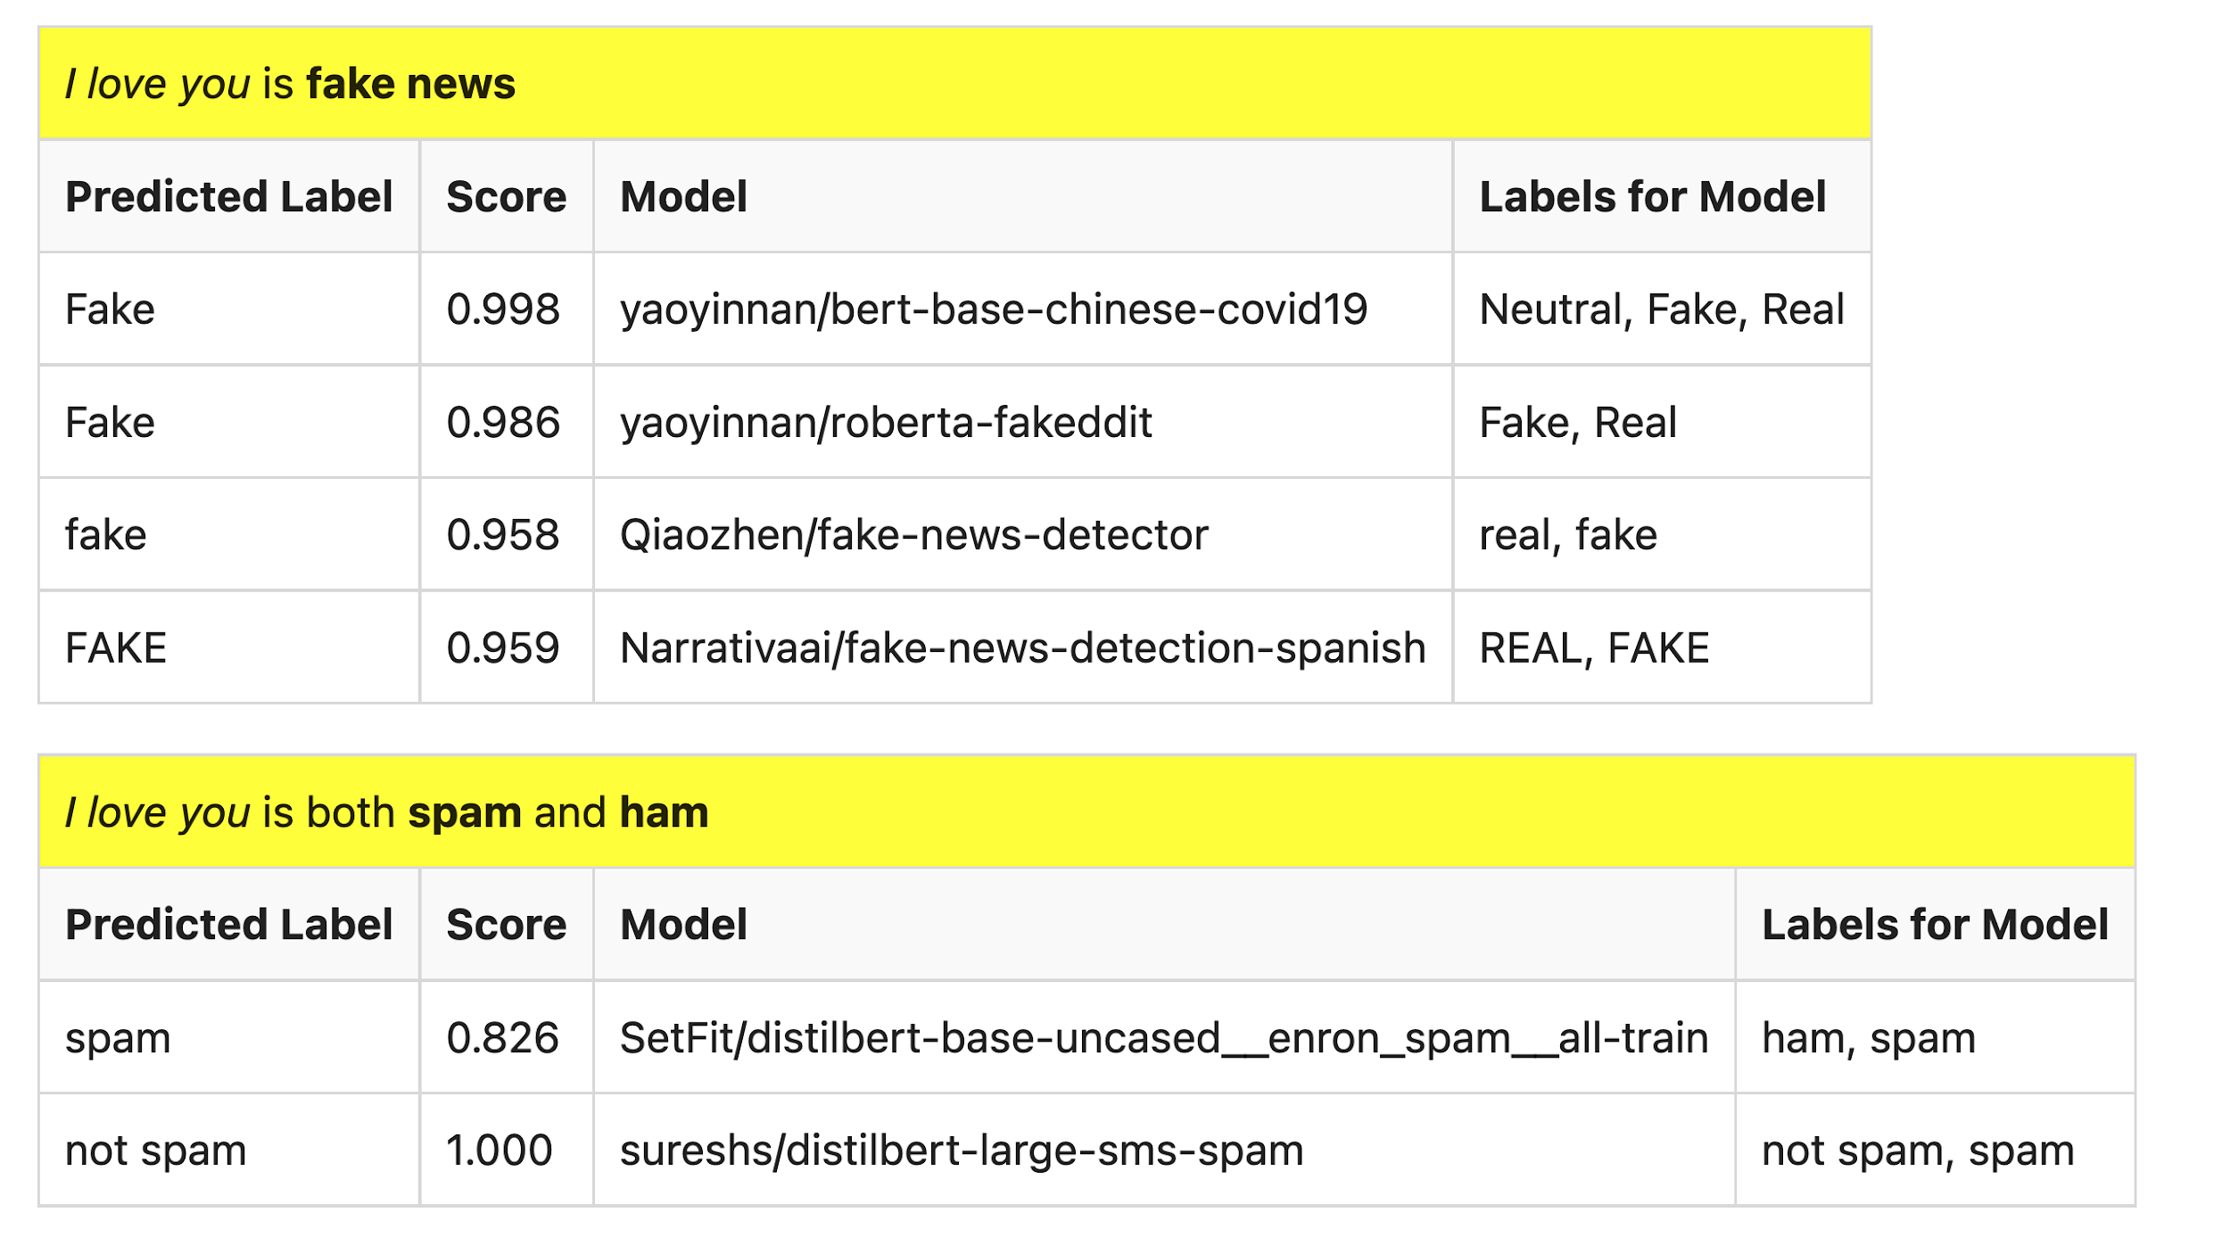
Many of these models produce reasonable results
Scores could be more confident

Slide 37
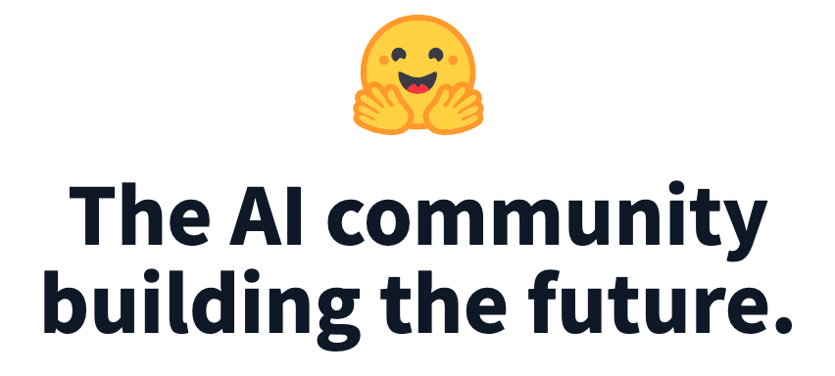
Lots of Models on Hubs (for lots of tasks)
Natural Language
Classification
Sentiment: positive/negative, 1-5 stars
Emotion classification
Hate speech classification
Guess missing word (fill-mask; cloze task)
Part of speech tagging
NER (named entity recognition)
Question Answering (SQUAD)
Entailment (GLUE)
Image Classification
Speech recognition
Machine Translation
Examples of fill-mask
echo … | gft_predict --task fill-mask
I <mask> you
miss|0.295
love|0.174
salute|0.158
I love the <mask> guy
pizza|0.035
funny|0.016
old|0.010
Examples of machine translation
echo …| gft_predict --task translation \
--model H:Helsinki-NLP/opus-mt-en-fr
I love you
Je t'aime.
2k translation models
on HuggingFace

Slide 38
Standard 3-Step Recipe
Step | Description | Time | Hardware
1 | Pre-Training | Days/Weeks | Large GPU cluster
2 | Fine-Tuning (fit) | Hours/Days | 1+ GPUs
3 | Inference (predict) | Seconds/Minutes | 0+ GPUs
Not Hard

Slide 39
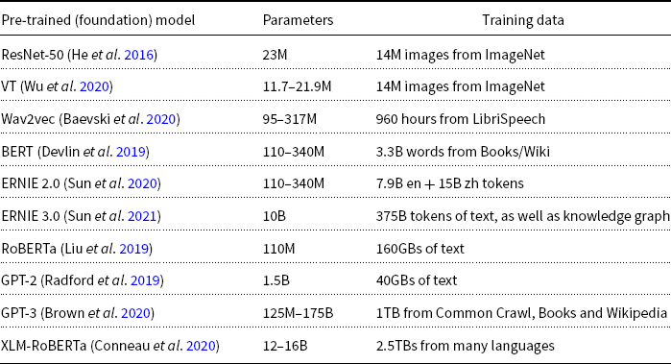
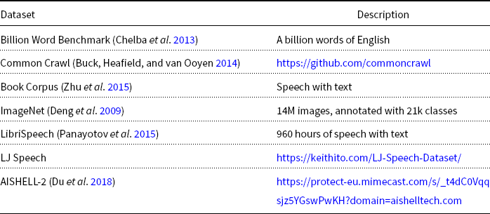
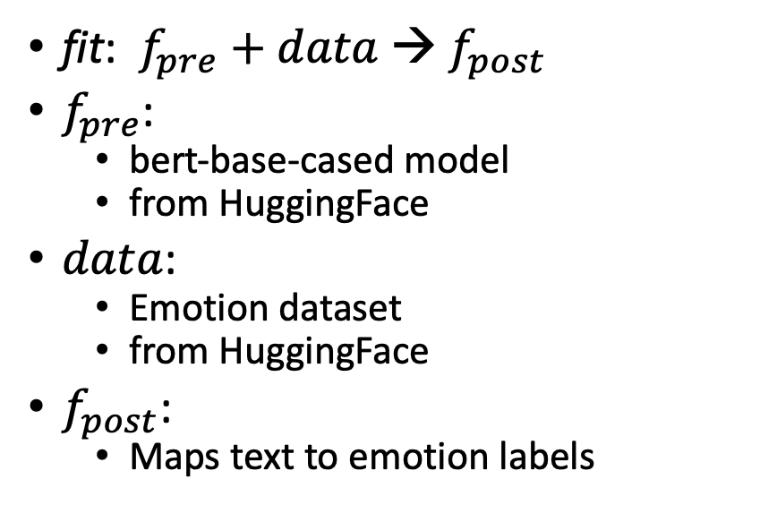
What is fine-tuning fit?
fit: $f_{pre}$ $+ data$→ $f_{post}$
$f_{pre}$:
bert-base-cased model
from HuggingFace
$data$:
Emotion dataset
from HuggingFace
$f_{post}$:
Maps text to emotion labels
R Program
gft Program

Slide 40
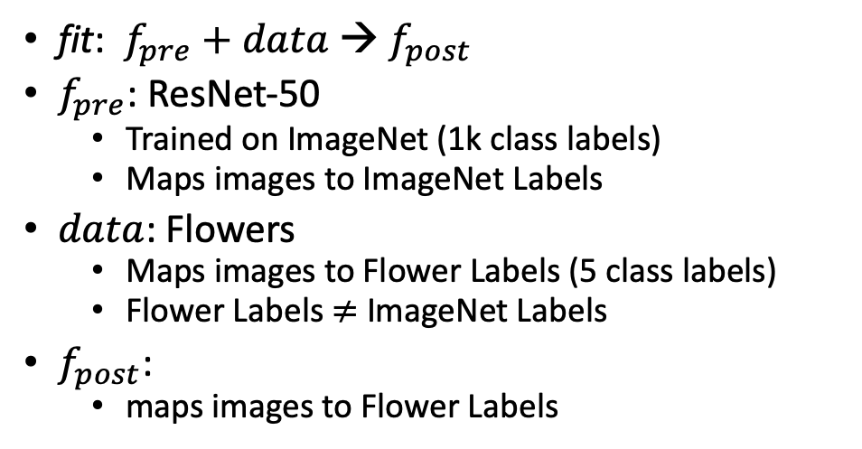

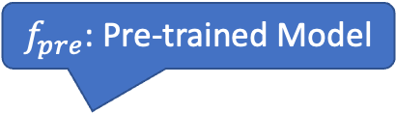
What is fine-tuning fit?
Flowers
$$data$$
fit: $f_{pre}$ $+ data$→ $f_{post}$
$f_{pre}$: ResNet-50
Trained on ImageNet (1k class labels)
Maps images to ImageNet Labels
$data$: Flowers
Maps images to Flower Labels (5 class labels)
Flower Labels $≠$ ImageNet Labels
$f_{post}$:
maps images to Flower Labels
$f_{pre}$: Pre-trained Model

Slide 41
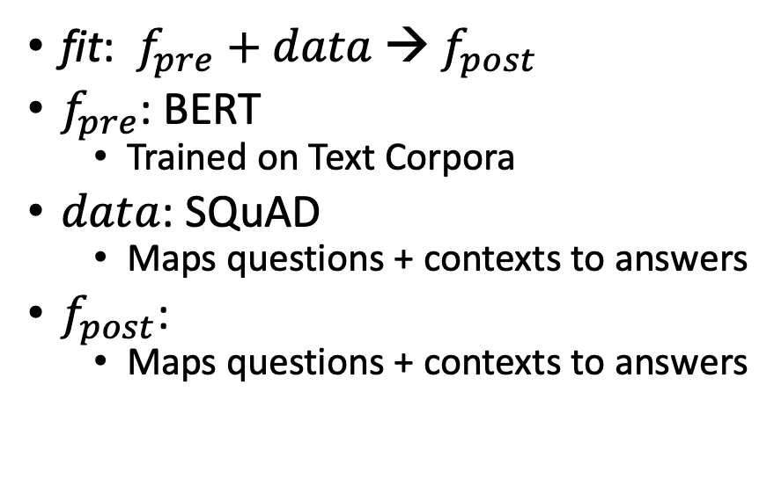
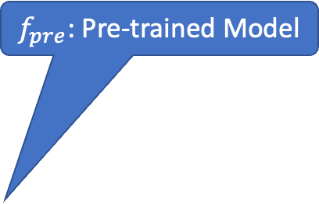
What is fine-tuning fit?
SQuAD
fit: $f_{pre}$ $+ data$→ $f_{post}$
$f_{pre}$: BERT
Trained on Text Corpora
$data$: SQuAD
Maps questions + contexts to answers
$f_{post}$:
Maps questions + contexts to answers
Question:
What does AFC stand for?
Context:
The American Football Conference (AFC) champion Denver Broncos defeated the National Football Conference (NFC) champion Carolina Panthers 24–10 to earn their third Super Bowl title.
Answer:
American Football Conference
Text with no markup
$f_{pre}$: Pre-trained Model

Slide 42
Strategy Conclusions
Inclusiveness
Appeal to Power Users as well as Masses
Accessible to Masses
Portability
Transparency
Avoid Magic / Alchemy
Hide Complexity
Embrace Historical Precedents
Little Languages from Unix
Fit/Predict/Summary/glm Equations from R

Slide 43
Agenda: Part A
Strategy
gft Cheatsheet
4-5 Functions + 4 Arguments
Amazing how much can be done with so little
Seven Simple Examples
More Tasks: MT, ASR, Vision
Two Questions
How do we find the good stuff?
How do we use the good stuff?
Why de-emphasize pre-training?
Conclusions

Slide 44
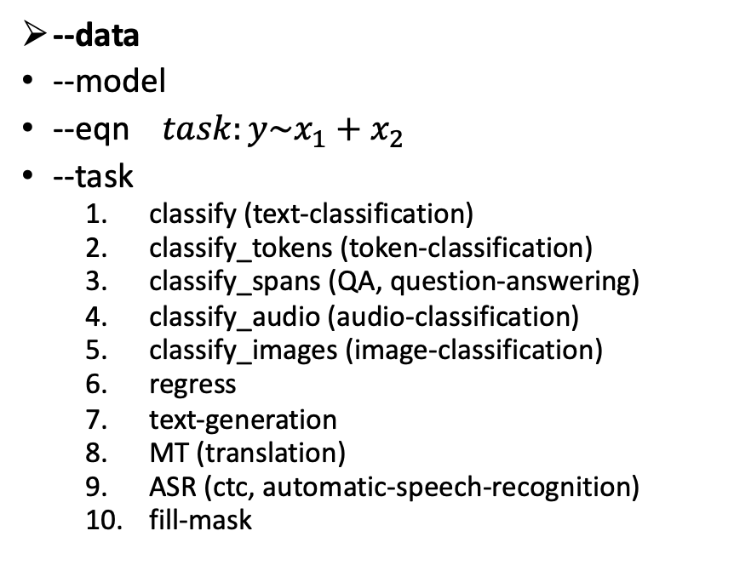
gft Cheat Sheet (General Fine-Tuning)
Next topic
4+1 Functions
4 Arguments
gft_fit: $f_{pre}$ →$f_{post}$(fine-tuning)
4 Arguments, --output_dir, --metric, --splits
(plus most args in most hubs)
gft_predict: $f\left(x\right)→\hat{y}$ (inference)
Input: 4 Arguments ($x$ from data or stdin)
Output: $\hat{y}$ for each $x$
gft_eval: Score model on dataset
Input: 4 Arguments, --split, --metric, …
Output: Score
gft_summary: Find good stuff
Input: 4 Arguments
(may include: __contains__, __infer__)
gft_cat_dataset: Output data to stdout
Input: 4 Arguments (--data, --eqn)
--data
--model
--eqn $task:y\sim x_{1}+x_{2}$
--task
classify (text-classification)
classify_tokens (token-classification)
classify_spans (QA, question-answering)
classify_audio (audio-classification)
classify_images (image-classification)
regress
text-generation
MT (translation)
ASR (ctc, automatic-speech-recognition)
fill-mask

Slide 45

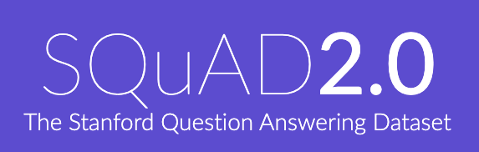
Two Popular Datasets
https://gluebenchmark.com/
https://rajpurkar.github.io/SQuAD-explorer/

Slide 46
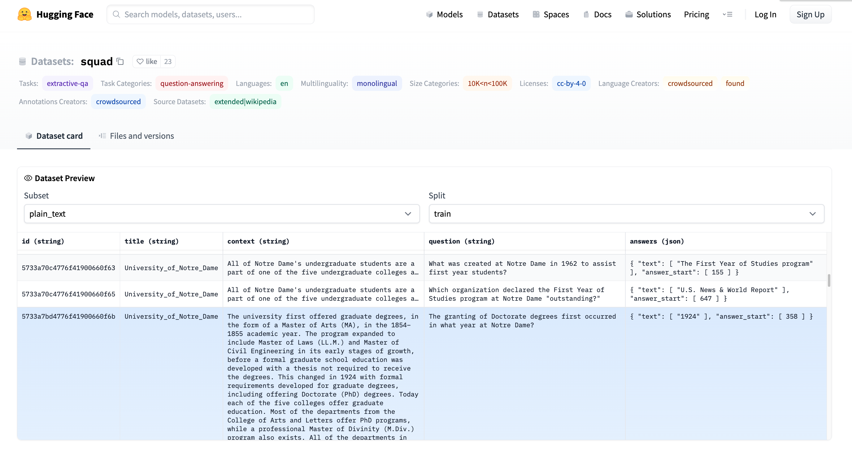
More Terminology
Dataset (4k)
Splits: train, validation, test
Columns:
id, title, context, question, answers
Rows
Models (36k)
Tasks:
classification, regression, etc.
https://huggingface.co/datasets/squad/viewer/plain_text/train

Slide 47
More Terminology
Answer starts at context[358:]
Dataset (4k)
Splits: train, validation, test
Columns:
title, context, question, answers
Rows
Answer is a span
(substring of context)
Task: Question-Answering (QA)
Classify Spans:
Answer is a substring of context

Slide 48

GLUE https://huggingface.co/datasets/glue/viewer/qqp/train

Slide 49

GLUE https://huggingface.co/datasets/glue/viewer/qqp/train
Terminology: Subset

Slide 50

GLUE https://huggingface.co/datasets/glue/viewer/qqp/train
Terminology: Splits
Terminology:
label or $y$

Slide 51

gft Cheat Sheet (General Fine-Tuning)
Next topic
4+1 Functions
4 Arguments
gft_fit: $f_{pre}$ →$f_{post}$(fine-tuning)
4 Arguments, --output_dir, --metric, --splits
(plus most args in most hubs)
gft_predict: $f\left(x\right)→\hat{y}$ (inference)
Input: 4 Arguments ($x$ from data or stdin)
Output: $\hat{y}$ for each $x$
gft_eval: Score model on dataset
Input: 4 Arguments, --split, --metric, …
Output: Score
gft_summary: Find good stuff
Input: 4 Arguments
(may include: __contains__, __infer__)
gft_cat_dataset: Output data to stdout
Input: 4 Arguments (--data, --eqn)
--data
--model
--eqn $task:y\sim x_{1}+x_{2}$
--task
classify (text-classification)
classify_tokens (token-classification)
classify_spans (QA, question-answering)
classify_audio (audio-classification)
classify_images (image-classification)
regress
text-generation
MT (translation)
ASR (ctc, automatic-speech-recognition)
fill-mask

Slide 52






Models https://huggingface.co/models
Terminology:
$$f,f_{pre},f_{post}$$
Task:
Fill Mask
Terminology:
$f_{pre}$ (base)
Terminology:
$$f_{pre}$$
Task:
Translation
Terminology:
$f_{post}$ (finetuned)
Terminology:
$$f_{pre}$$
Task:
Token classification

Slide 53

gft Cheat Sheet (General Fine-Tuning)
4+1 Functions
4 Arguments
gft_fit: $f_{pre}$ →$f_{post}$(fine-tuning)
4 Arguments, --output_dir, --metric, --splits
(plus most args in most hubs)
gft_predict: $f\left(x\right)→\hat{y}$ (inference)
Input: 4 Arguments ($x$ from data or stdin)
Output: $\hat{y}$ for each $x$
gft_eval: Score model on dataset
Input: 4 Arguments, --split, --metric, …
Output: Score
gft_summary: Find good stuff
Input: 4 Arguments
(may include: __contains__, __infer__)
gft_cat_dataset: Output data to stdout
Input: 4 Arguments (--data, --eqn)
--data
--model
--eqn $task:y\sim x_{1}+x_{2}$
--task
classify (text-classification)
classify_tokens (token-classification)
classify_spans (QA, question-answering)
classify_audio (audio-classification)
classify_images (image-classification)
regress
text-generation
MT (translation)
ASR (ctc, automatic-speech-recognition)
fill-mask
Next topic

Slide 54



Loss Functions and Metrics (Defaults depend on task)
--eqn
$classify : label \sim question+sentence$
$regress : label \sim question1+question2$
Loss functions (used in gft_fit)
Classification → Cross entropy
Regression → Mean squared error
Metrics (used in gft_eval)
Classification → Accuracy
Regression → Mean squared error
--metric H:glue,cola → Matthews Correlation
Concern: Loss $≠$ Metric
Concern: Loss $≠$ Metric

Slide 55



$$regress: Valence + Arousal + Dominance \sim Word$$ https://saifmohammad.com/WebPages/nrc-vad.html
$ℝ^{3}$

Slide 56


$$regress: Valence + Arousal + Dominance \sim Word$$ https://saifmohammad.com/WebPages/nrc-vad.html
$ℝ^{3}$
Train $f$on words, but apply $f$ to texts
(Generalizations: OOVs, MWEs, negation)

Slide 57

Terminology
0-shot
Standard Terminology | Proposed Alternatives
Base/Foundation/Pre-Trained | $$f_{pre}$$
Fine-Tuning | fit
Inference | predict
Unsupervised
Supervised
Emphasize this
Emphasize this
Few-shot
De-emphasize this
Teaser: Stay-tuned

Slide 58







gft (general fine-tuning): A Little Language for Deep Nets (Unix Philosophy: Less is More)
Standard 3-Step Recipe
Examples of 1-line GFT Programs
Step 2: gft_fit
Data
$f_{pre}$: Pre-trained Model
Terminology borrowed from sklearn:
fit: $f_{pre}$ $+ data$→ $f_{post}$
predict: $f\left(x\right)→\hat{y}$
fit and predict are (almost) all you need
gft programs are short (1-line)
No (not much) programming required
No python in this tutorial
Examples on hubs are (unnecessarily) long/complicated
$f_{post}$: Post-trained Model
Step 3: gft_predict
$$x$$
$$\hat{y}$$
Score

Slide 59

gft Cheat Sheet (General Fine-Tuning)
Amazing how much can be done with so little
4+1 Functions
4 Arguments
gft_fit: $f_{pre}$ →$f_{post}$(fine-tuning)
4 Arguments, --output_dir, --metric, --splits
(plus most args in most hubs)
gft_predict: $f\left(x\right)→\hat{y}$ (inference)
Input: 4 Arguments ($x$ from data or stdin)
Output: $\hat{y}$ for each $x$
gft_eval: Score model on dataset
Input: 4 Arguments, --split, --metric, …
Output: Score
gft_summary: Find good stuff
Input: 4 Arguments
(may include: __contains__, __infer__)
gft_cat_dataset: Output data to stdout
Input: 4 Arguments (--data, --eqn)
--data
--model
--eqn $task:y\sim x_{1}+x_{2}$
--task
classify (text-classification)
classify_tokens (token-classification)
classify_spans (QA, question-answering)
classify_audio (audio-classification)
classify_images (image-classification)
regress
text-generation
MT (translation)
ASR (ctc, automatic-speech-recognition)
fill-mask

Slide 60
Some Popular Datasets
https://gluebenchmark.com/
https://rajpurkar.github.io/SQuAD-explorer/

Slide 61
Outline
Make deep nets accessible to masses (including non-programmers)
Part A: Glass is half-full
Deep nets can do much
Part B: Glass is half-empty
There is always more work to do
Advocate combo of Part A with
AI Knowledge Representation
Linguistics and Philosophy
GFT Code,
100s of examples,
slides, videos, papers

Slide 62
Agenda: Part A
Strategy
gft Cheatsheet
4-5 Functions + 4 Arguments
Amazing how much can be done with so little
Seven Simple Examples
More Tasks: MT, ASR, Vision
Two Questions
How do we find the good stuff?
How do we use the good stuff?
Why de-emphasize pre-training?
Conclusions

